Slide 1
Design of CYBER-SECURITY ENABLED SMART CONTROLLER for grid-connected Microgrid
CSE7101- Capstone Project
Review-1
Batch Number: CSE_47
Under the Supervision of,
Dr. Manju More E
Associate Professor
School of Computer Science and Engineering
Presidency University
Roll Number | Student Name
20221CSE0121 | Abdul Samad
20221CSE0048 | Siddique Ali Khan
20221CSE0026 | Mohammed Anzal A
Name of the Program: Computer Science & Engineering
Name of the HoD: Dr. Asif Mohammed
Name of the Program Project Coordinator: Dr. Jayavadivel Ravi
Name of the School Project Coordinators: Dr. Sampath A K , Dr. Geetha A

Slide 2
Problem Statement Number:
Organization: Presidency University - Ministry of Power
Category (Hardware / Software / Both) : Software
Problem Description:
Modern microgrids depend heavily on communication networks for control and monitoring, making them vulnerable to cyber-attacks such as False Data Injection (FDI), Denial-of-Service (DoS), and Man-in-the-Middle (MITM) attacks. Current controllers often focus on either performance or security, but lack integrated, real-time resilience mechanisms to ensure stability under attack.

Slide 3
Content
Problem Statement
Objectives
Background and Related work for title Selection
Analysis of Problem Statement
Background and Related Work
Innovation or Novel Contributions
GitHub Link
Timeline of the Project
References

Slide 4
Analysis of Problem Statement
Problem Statement Cyber-attacks such as False Data Injection (FDI), Denial of Service (DoS), and Man-in-the-Middle (MITM) pose serious risks to microgrid stability and security. Existing solutions often focus only on simulations or individual techniques without integrating detection, prevention, and logging in a single real-time platform.
Objectives
Simulate cyber-attacks on a microgrid using Linux-based tools.
Secure communication using ECC encryption.
Detect anomalies using a hybrid approach (threshold + ML).
Log events in a lightweight blockchain.
Develop a React.js dashboard for real-time monitoring and control.

Slide 5
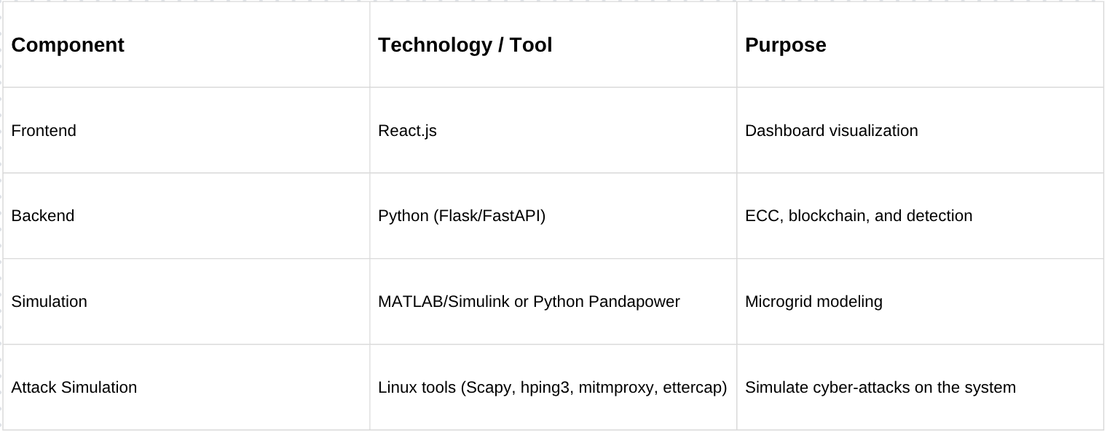
Analysis of Problem Statement
Technology Stack Components:

Slide 6
Background and Related Work:
Existing Research
ECC encryption widely applied in IoT secure communication.
Blockchain used for secure logging in energy systems.
ML-based anomaly detection for cyber-physical systems.
Limitations Found
Mostly simulation-only studies without real-time integration.
High computational cost for blockchain on low-power devices.
Single-approach detection methods lacking hybrid intelligence.

Slide 7
Innovation / Novel Contributions:
Novelty Integration of ECC encryption, blockchain logging, and hybrid anomaly detection in a single software platform, validated through realistic Linux-based cyber-attacks.
Key Contributions
Lightweight ECC encryption for low-latency secure communication.
Lightweight blockchain for tamper-proof event logging.
Hybrid detection system (threshold + ML) for improved accuracy.
React.js dashboard for real-time visualization and control.
Why Innovative?
Combines multiple proven techniques in a single working prototype.
Optimized for software-only real-time demonstration.
Flexible to extend into hardware in the future.

Slide 8

GitHub Link
Repository Name: microgrid-smart-controller
Public Link: https://github.com/siddiquealikhan/microgrid-smart-controller

Slide 9
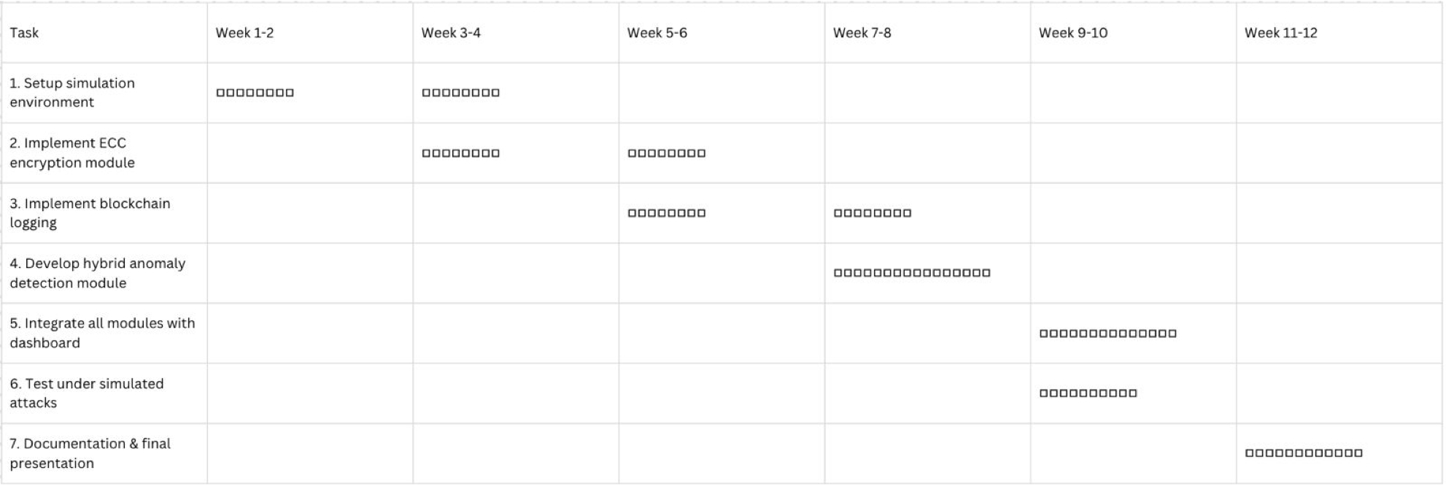
Timeline of the Project (Gantt Chart)

Slide 10
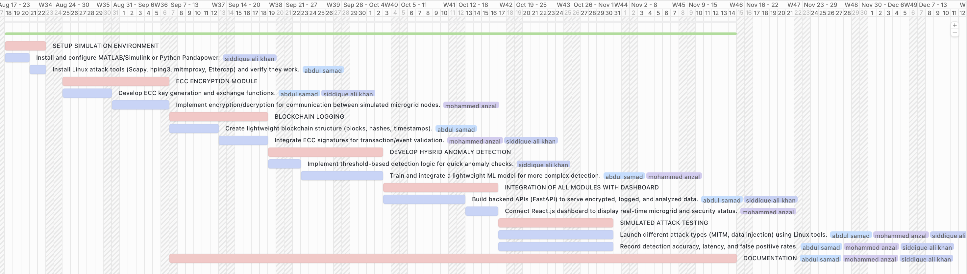

Timeline of the Project (Gantt Chart)
MAIN TASK
SUB - TASK

Slide 11
References (IEEE format)
[1] A. Ayele et al., “Secure Communication in Smart Grids using ECC,” IEEE Transactions on Smart Grid, vol. 14, no. 2, pp. 1021–1032, 2023.
[2] A. Ahmed et al., “Blockchain-based Event Logging for Energy Systems,” Sensors, vol. 22, no. 5, pp. 854–866, 2022.
[3] Y. Wang et al., “Resilient Control of Hybrid Microgrids under Cyber Attacks,” Energy Reports, vol. 10, pp. 112–123, 2024.

Slide 12


